Slide 1
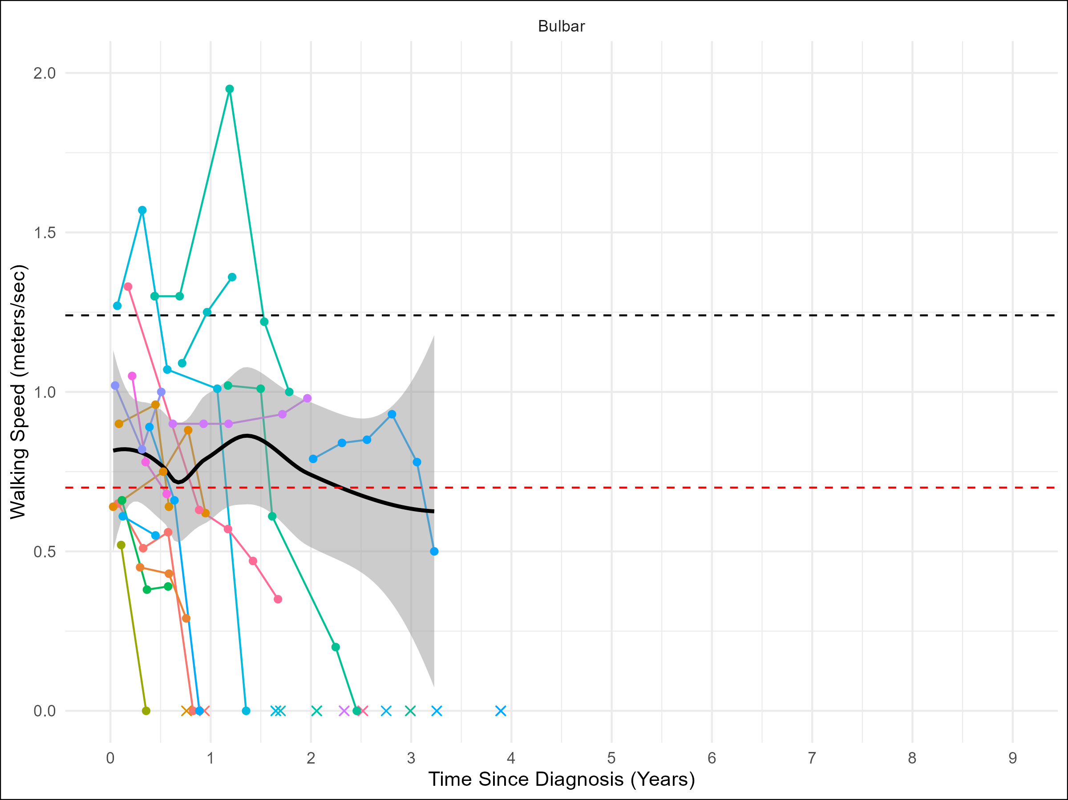
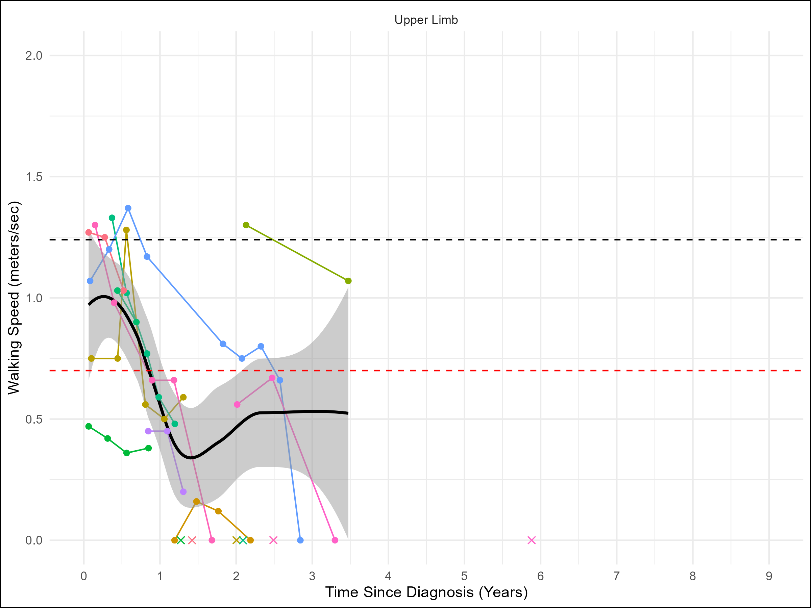
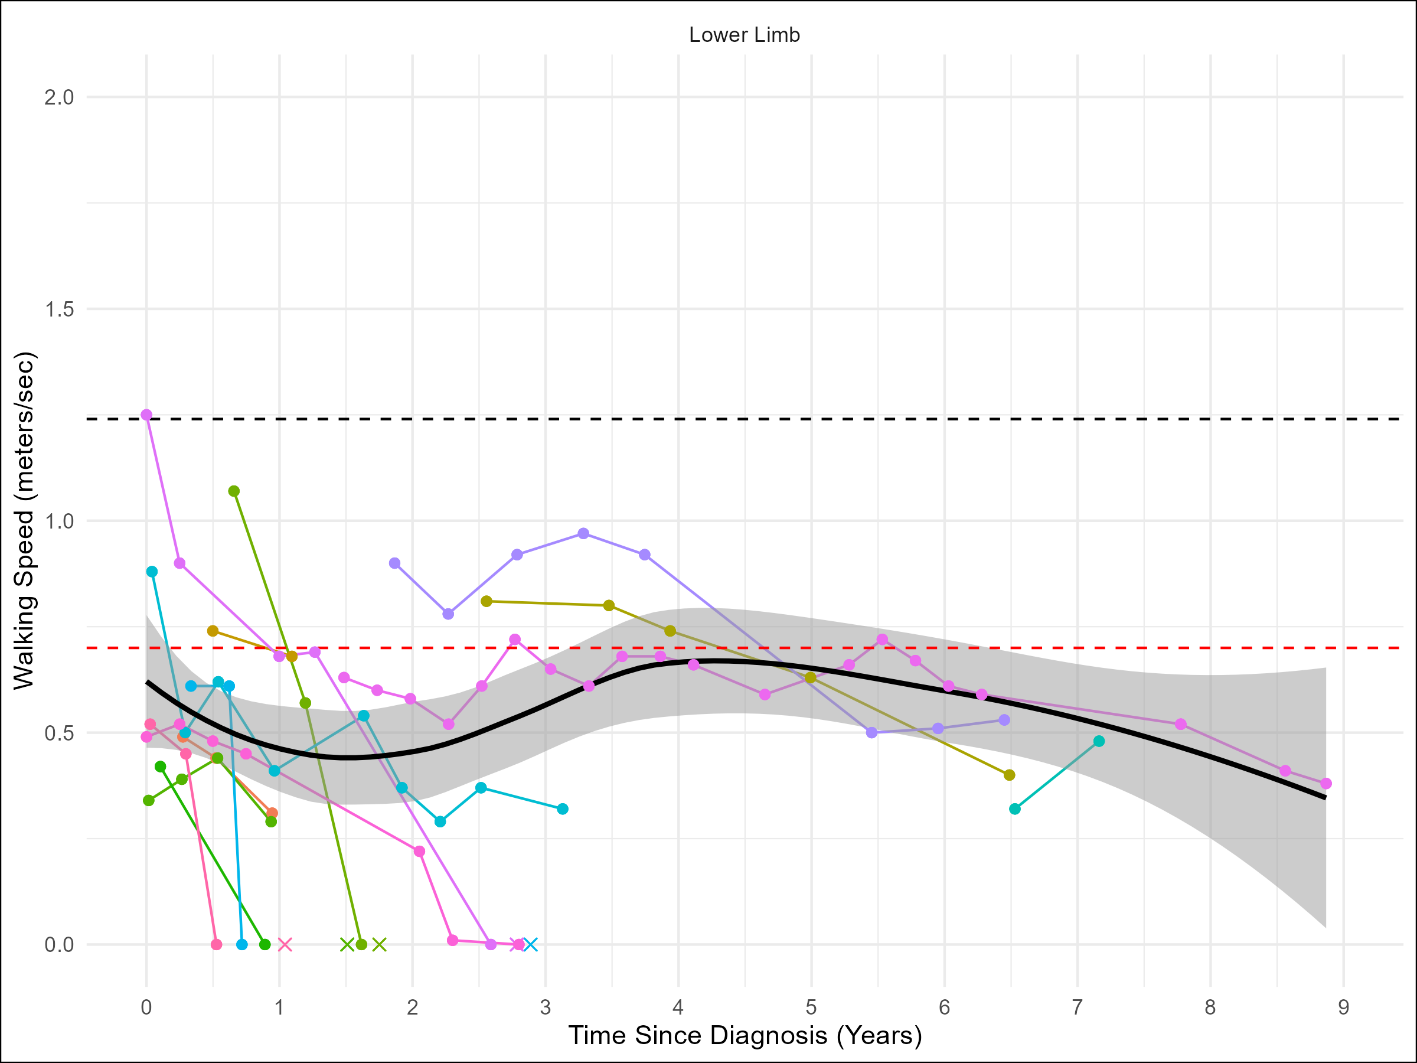
Figure 1: Gait speed with bulbar (A; n = 17), upper limb (B; n = 11), and lower limb (C; n = 14) onset over time since diagnosis in months. Each colored line represents a different patient. A smoothed average line and shaded 95% confidence interval are applied to graphs where n > 10. An ‘x’ indicates a patient death. A normative dashed line is displayed at 1.24 m/s. An adverse event dashed line is displayed in red at 0.7 m/s.

Slide 2
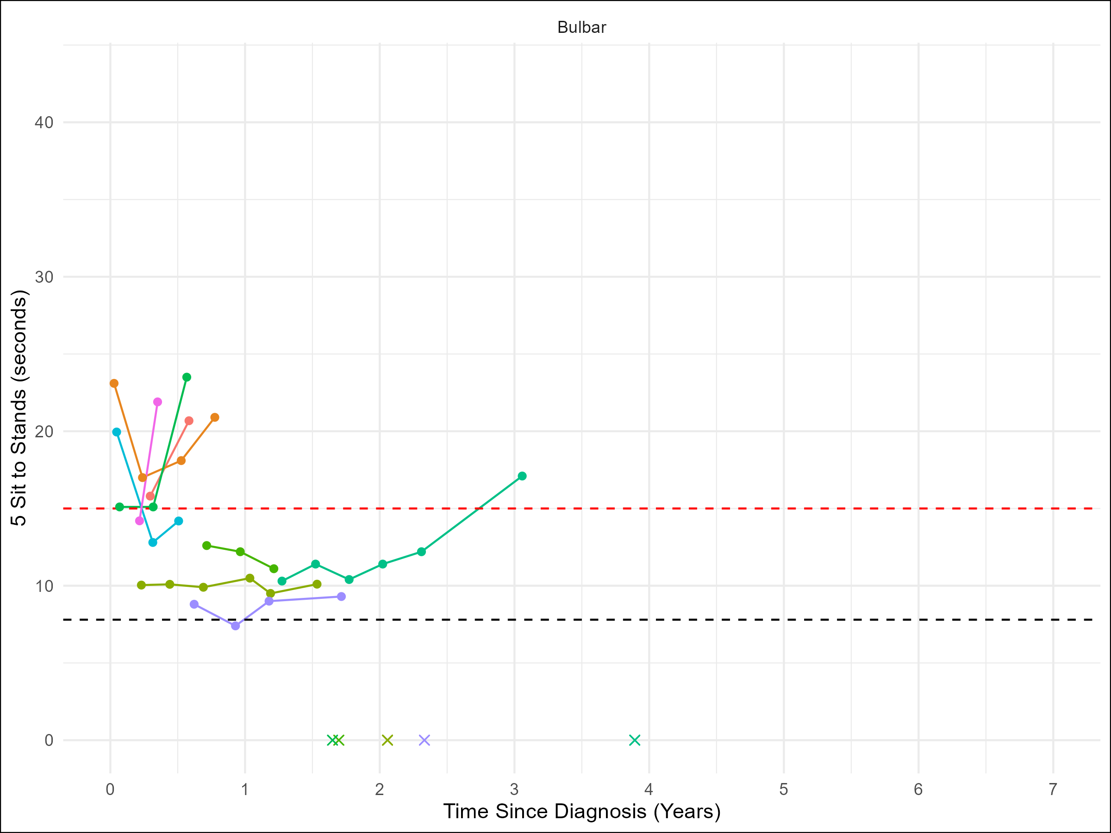
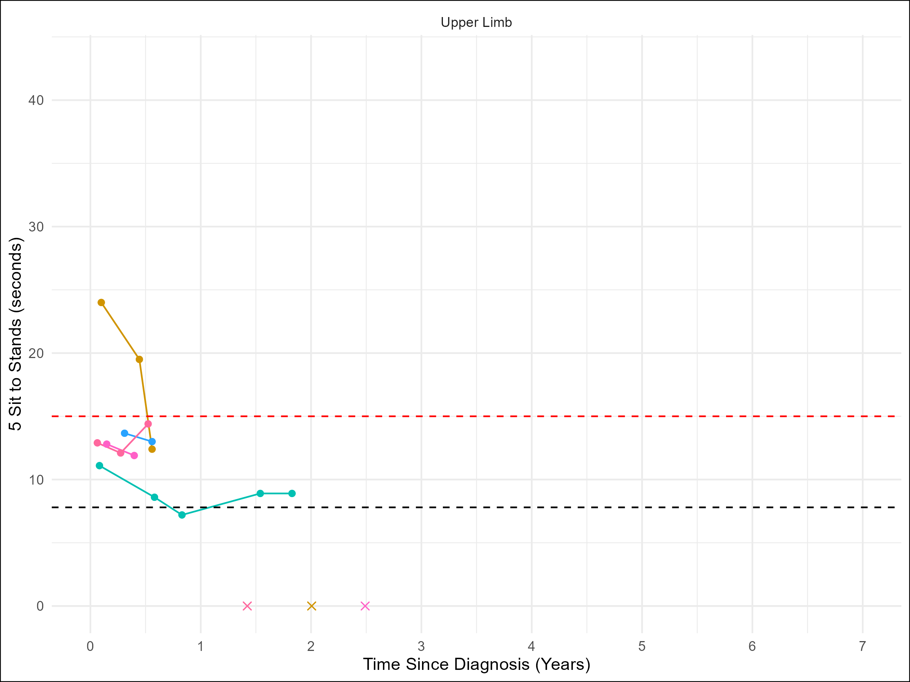
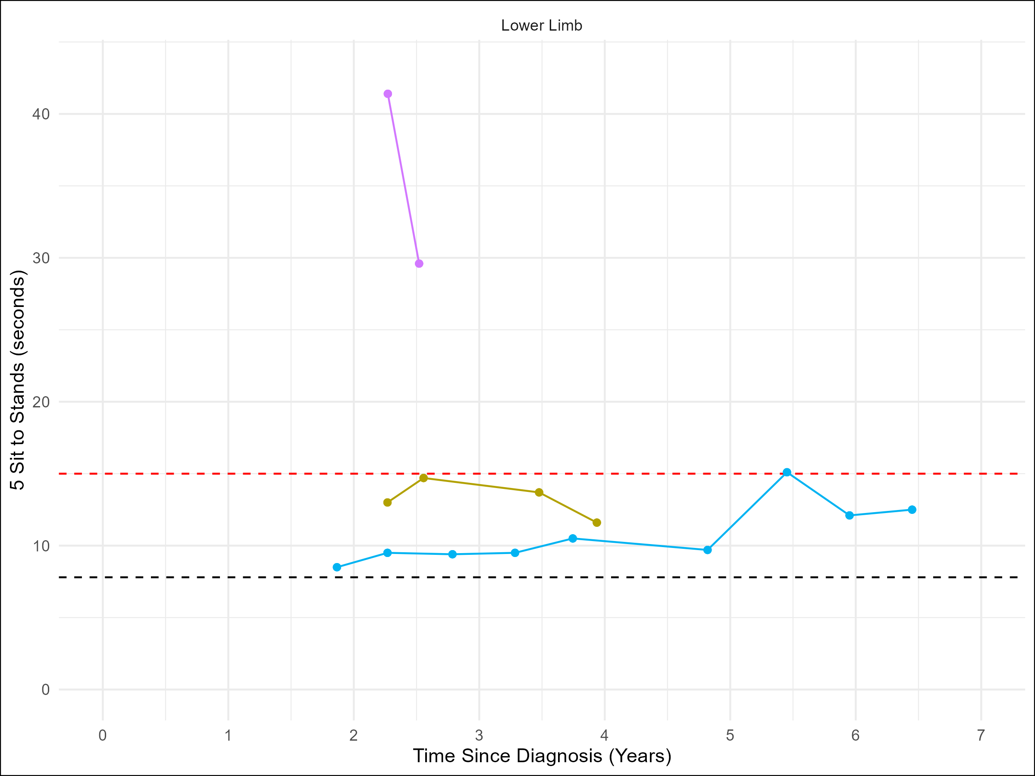
Figure 2: Sit to stand with bulbar (A; n = 9), upper limb (B; n = 5), and lower limb (C; n = 3) onset over time since diagnosis in months. Each colored line represents a different patient. An ‘x’ indicates a patient death. A normative dashed line is displayed at 7.8 seconds. An adverse event dashed line is displayed in red at 15.0 seconds.

Slide 3
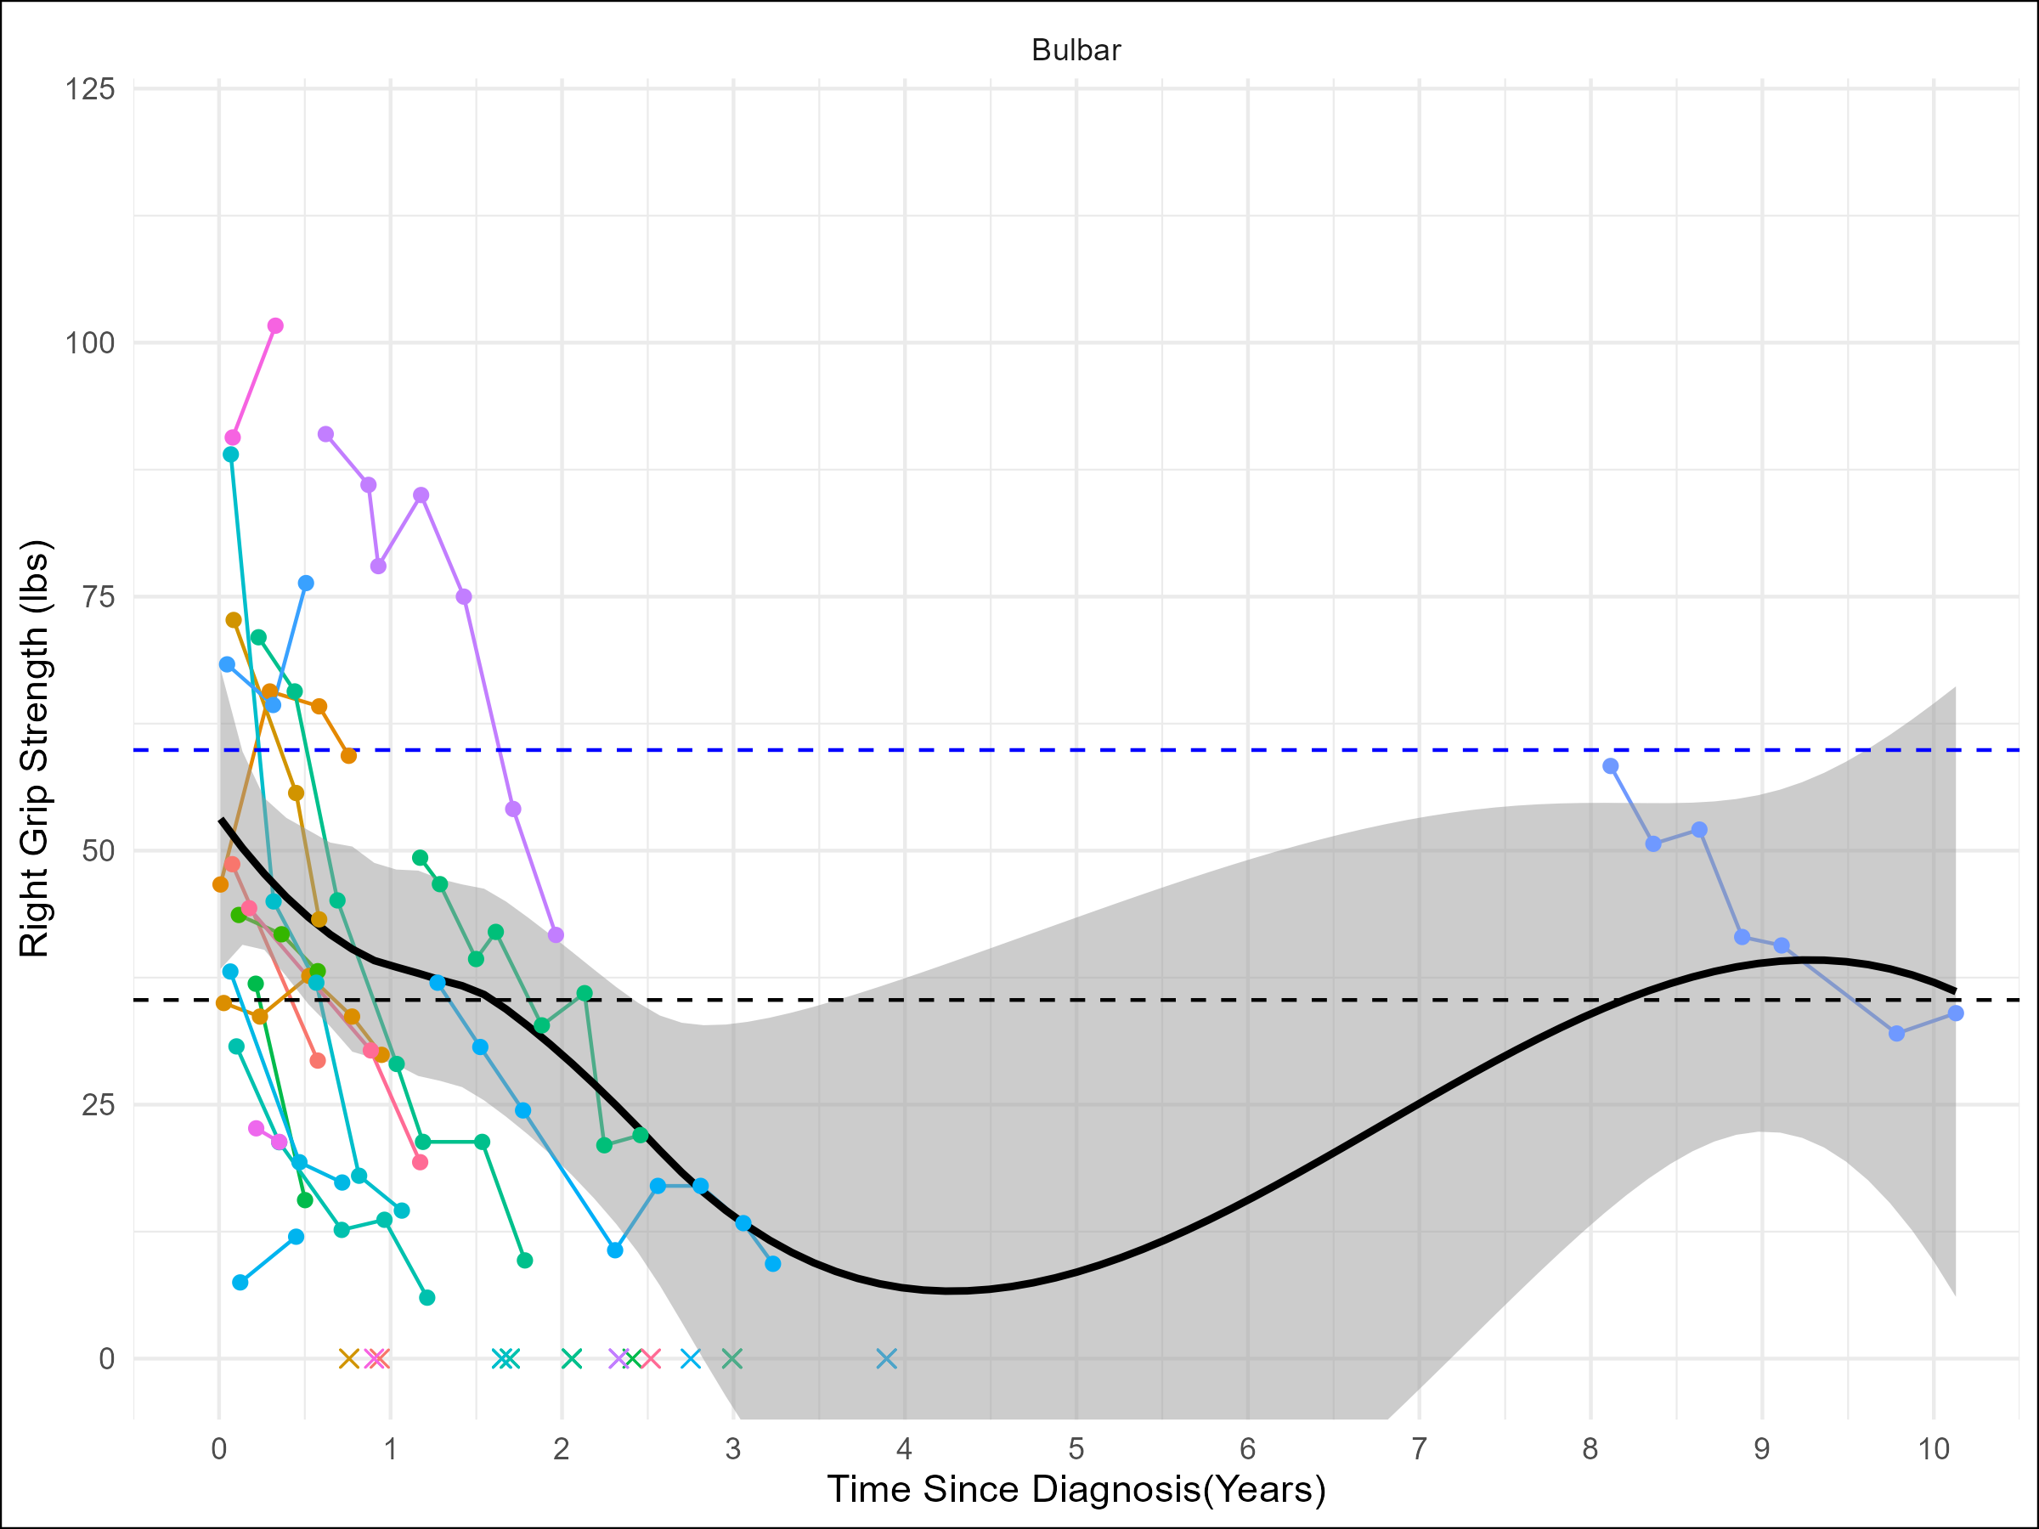
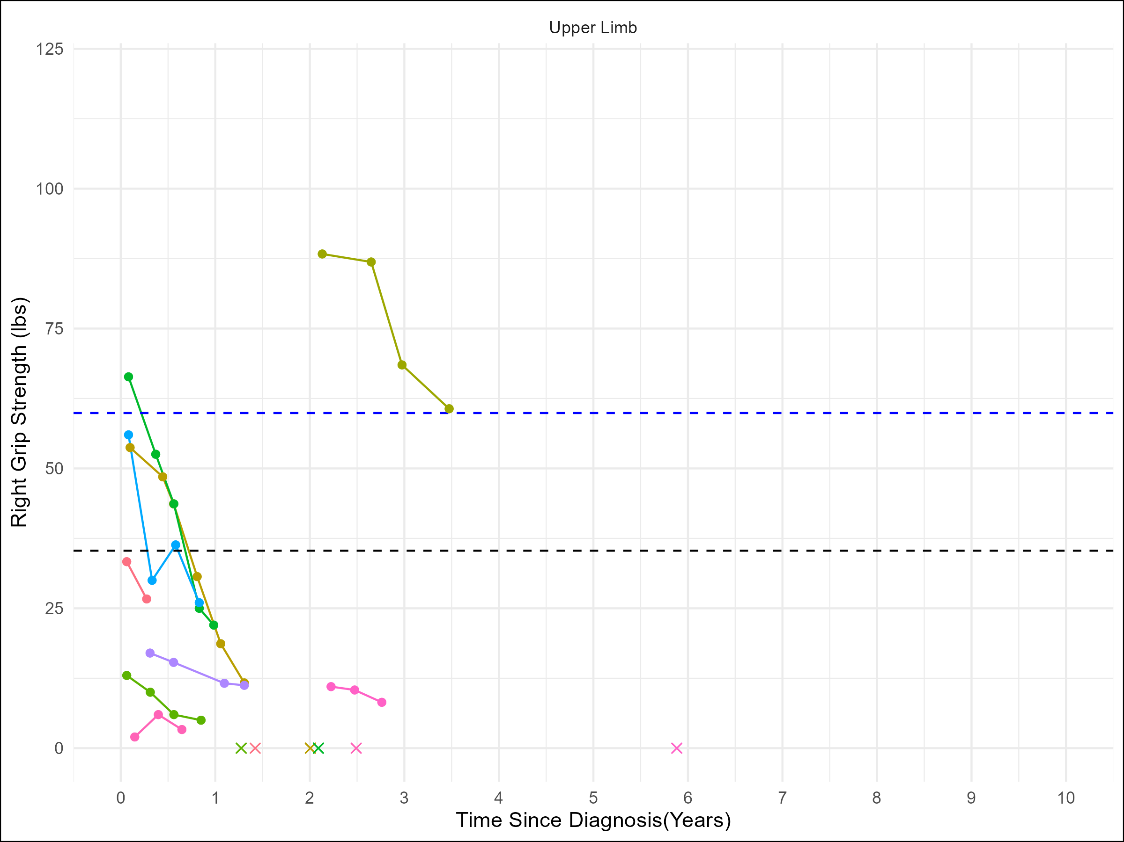
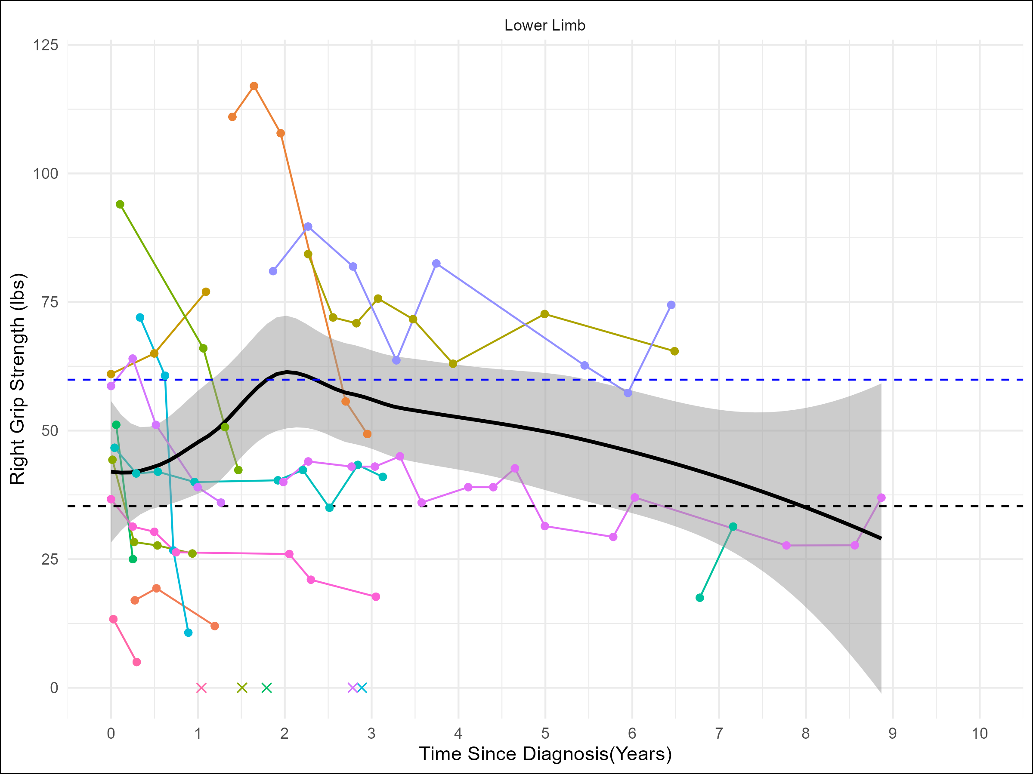
Figure 3: Right grip strength with bulbar (A; n = 19), upper limb (B; n = 9), and lower limb (C; n = 15) onset over time since diagnosis in months. Each colored line represents a different patient. A smoothed average line and shaded 95% confidence interval are applied to graphs where n > 10. A normative dashed blue line for men is displayed at 59.9 lbs. A normative dashed black line for women is displayed at 35.3. An ‘x’ indicates a patient death.

Slide 4
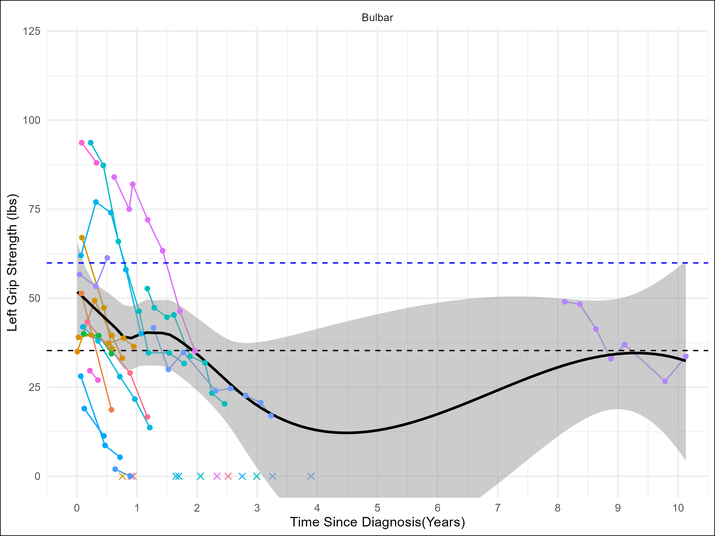
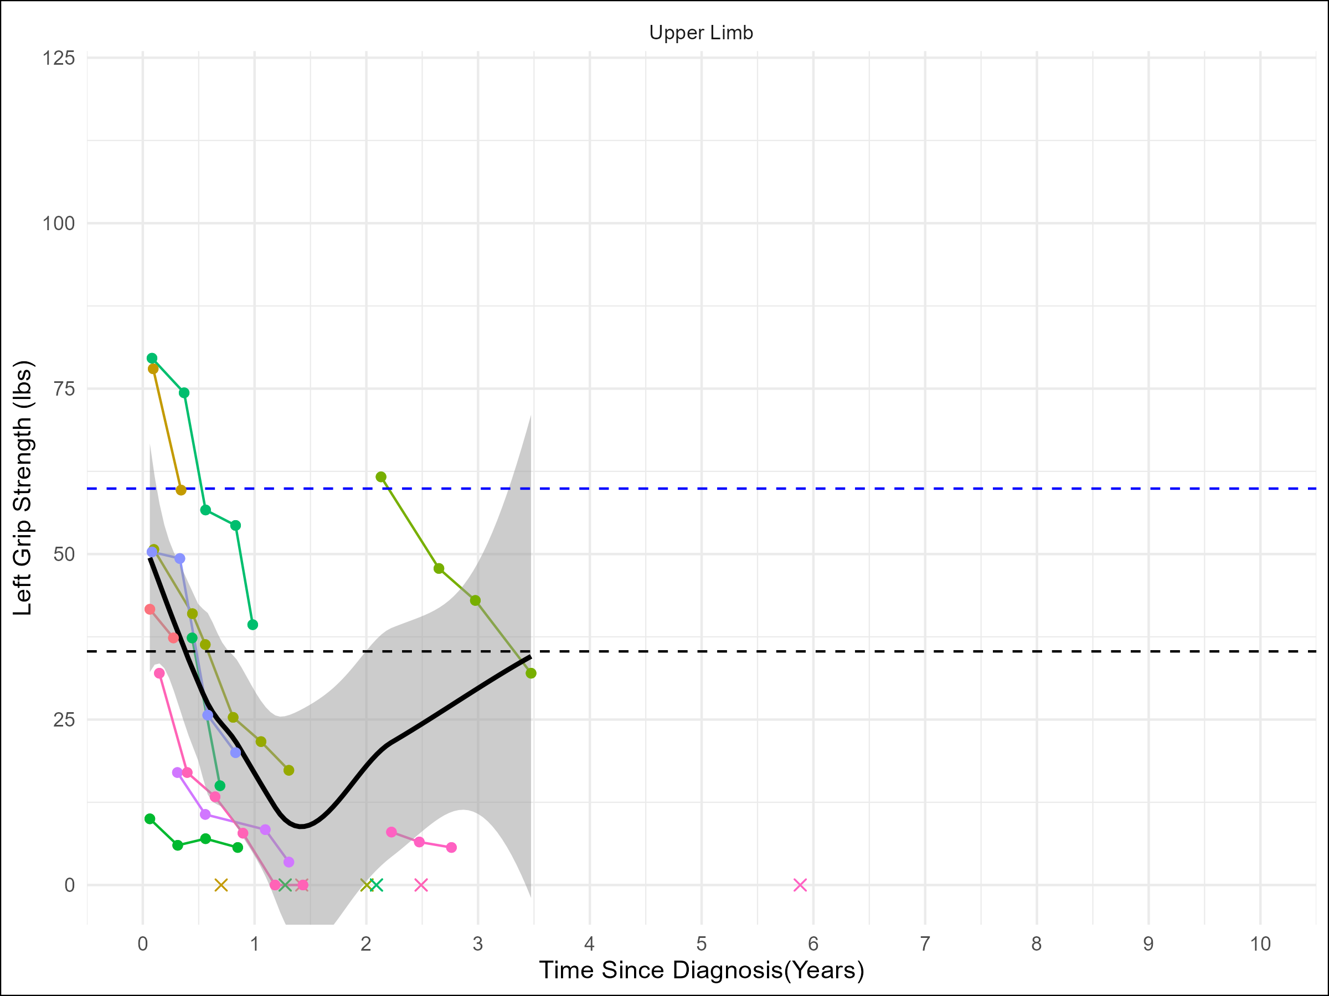
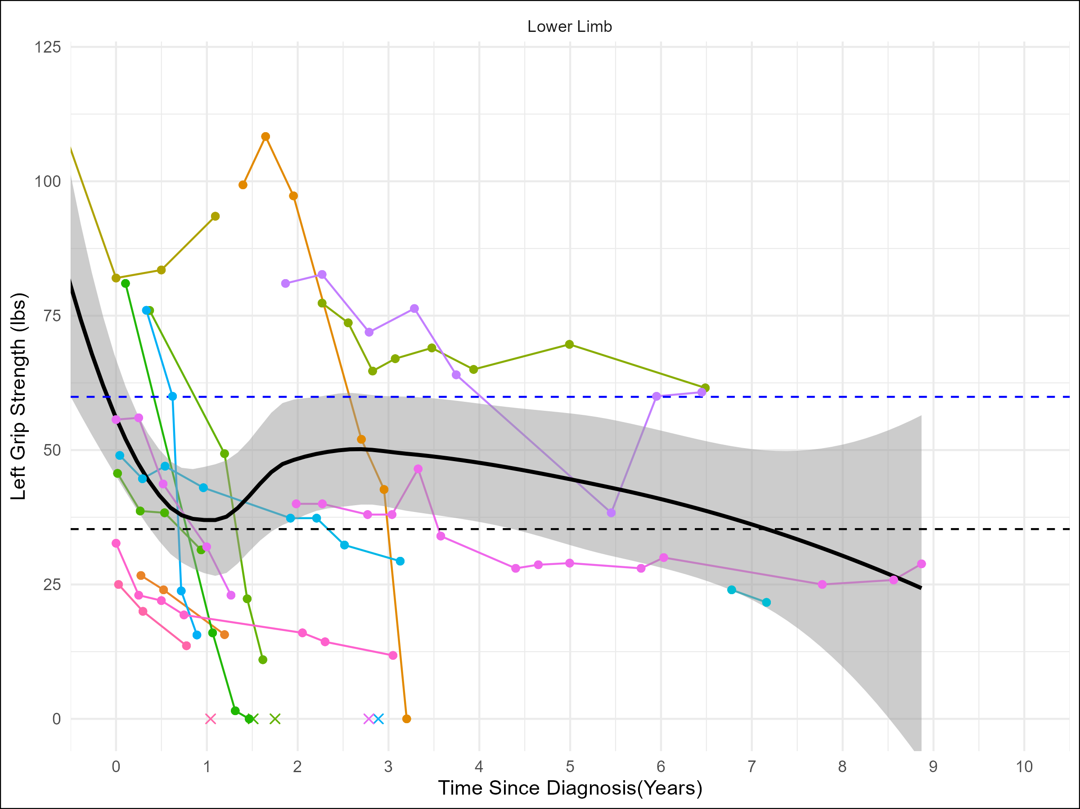
Figure 4: Left grip strength with bulbar (A; n = 19), upper limb (B; n = 11), and lower limb (C; n = 15) onset over time since diagnosis in months. Each colored line represents a different patient. A smoothed average line and shaded 95% confidence interval are applied to graphs where n > 10. A normative dashed blue line for men is displayed at 59.9 lbs. A normative dashed black line for women is displayed at 35.3. An ‘x’ indicates a patient death.

Slide 5
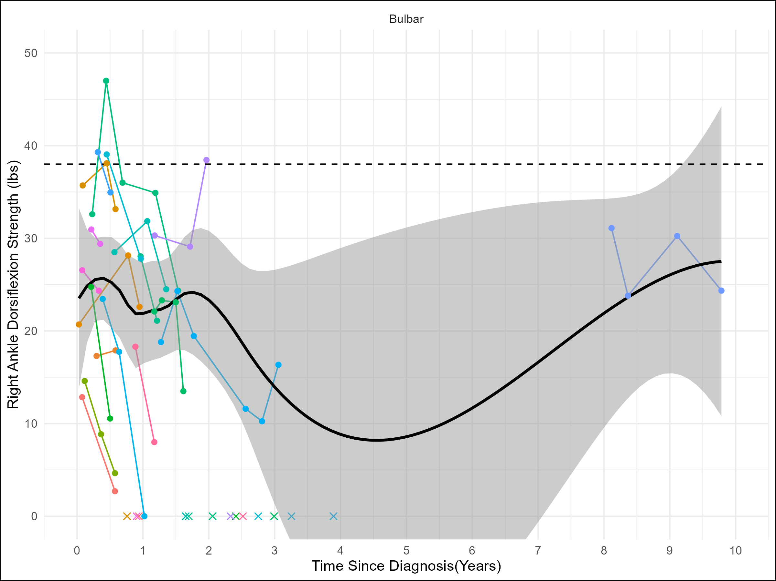
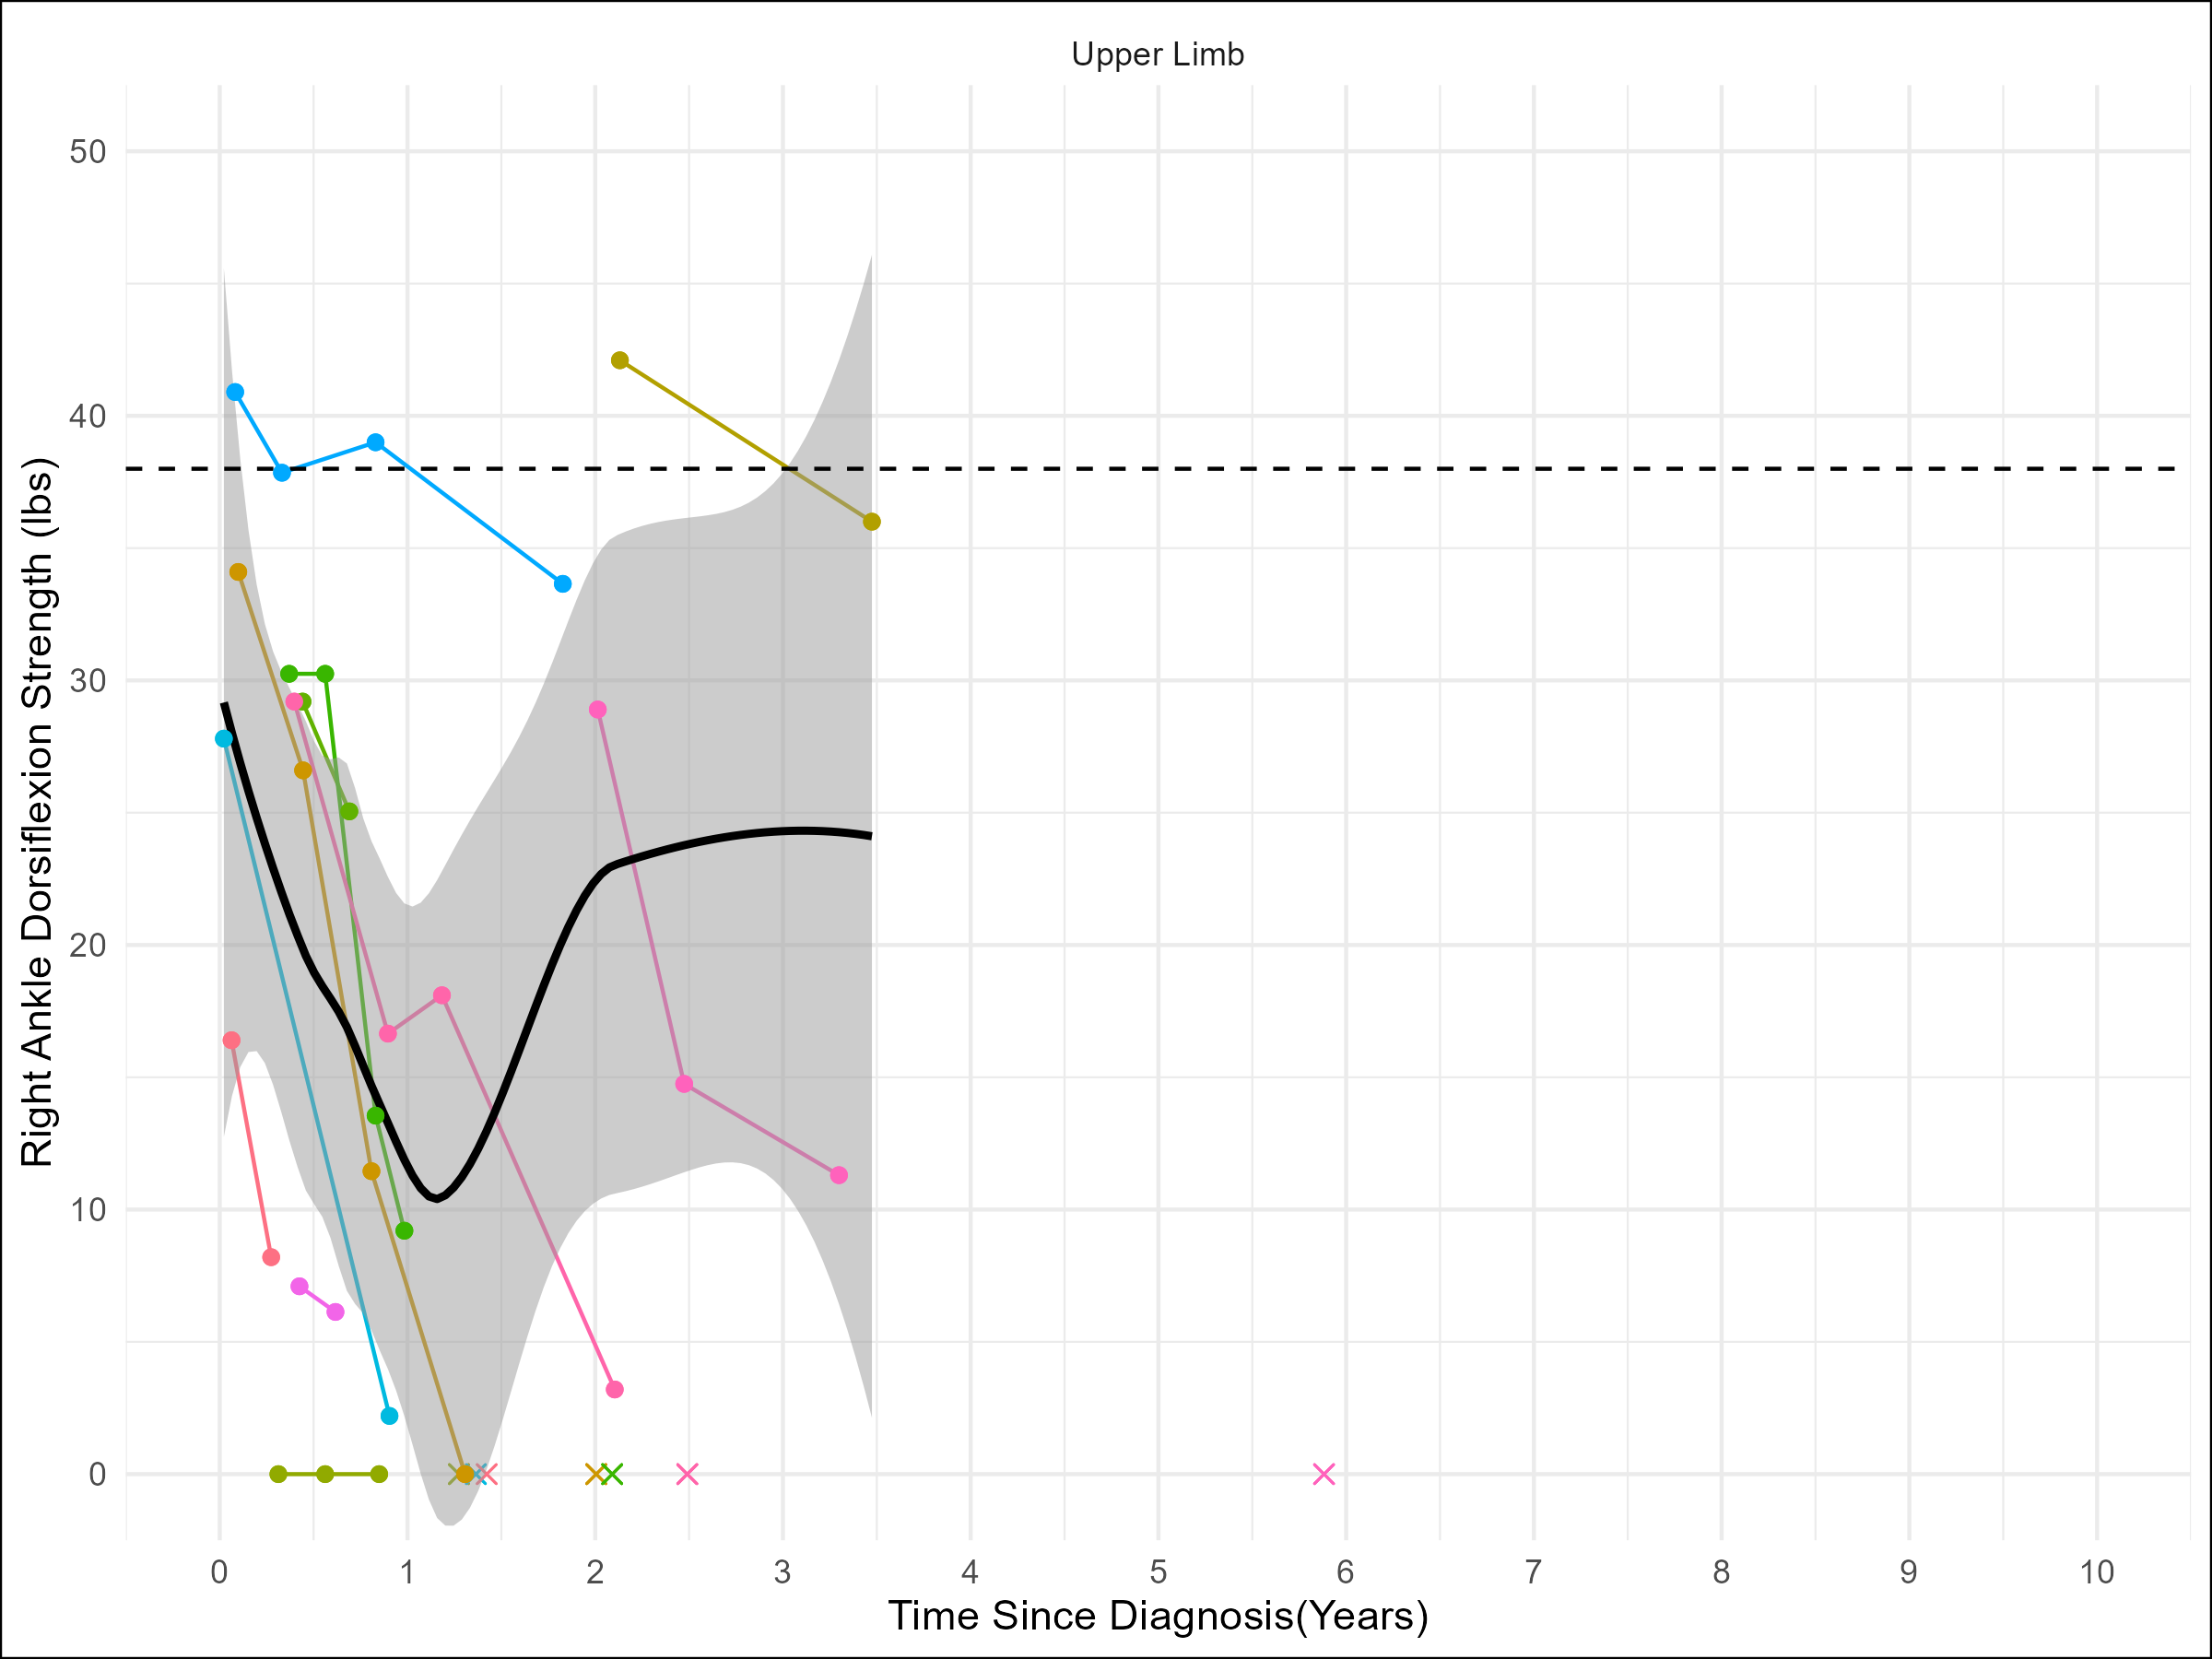
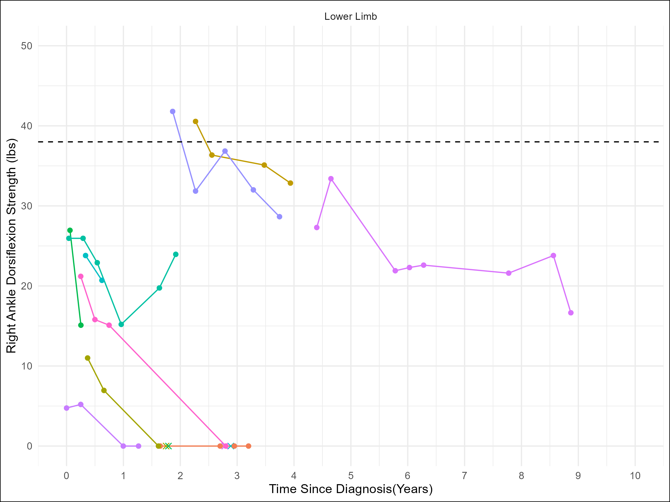
Figure 5: Right ankle flexion with bulbar (A; n = 19), upper limb (B; n = 11), and lower limb (C; n = 10) onset over time since diagnosis in months. Each colored line represents a different patient. A smoothed average line and shaded 95% confidence interval are applied to graphs where n > 10. A normative dashed black is displayed at 38 lbs. An ‘x’ indicates a patient death.

Slide 6
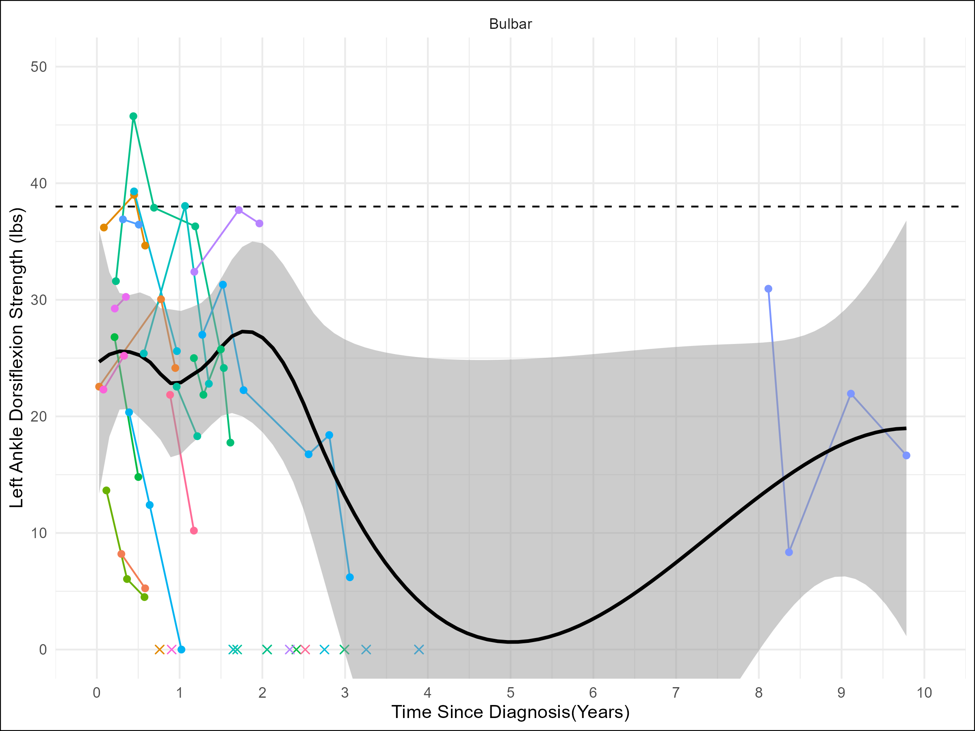
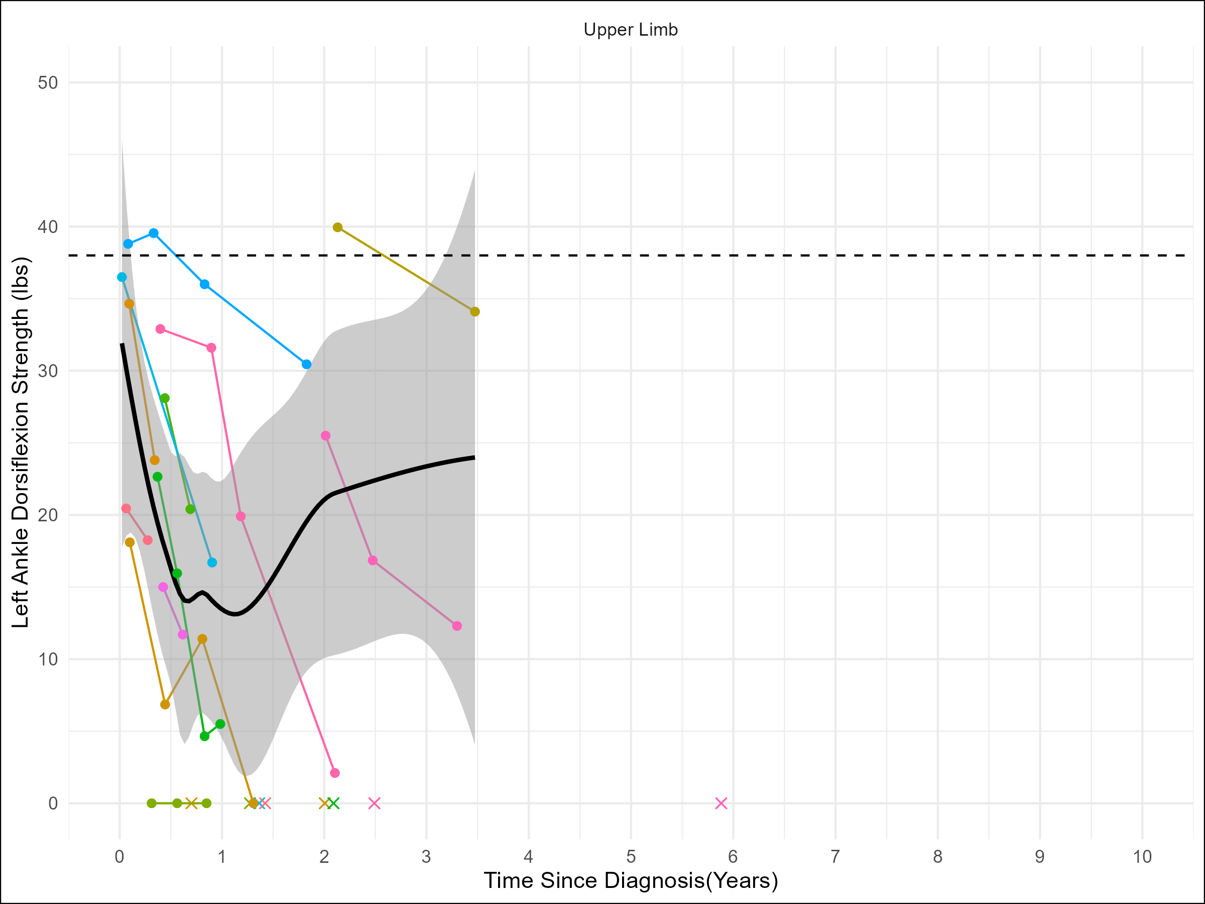
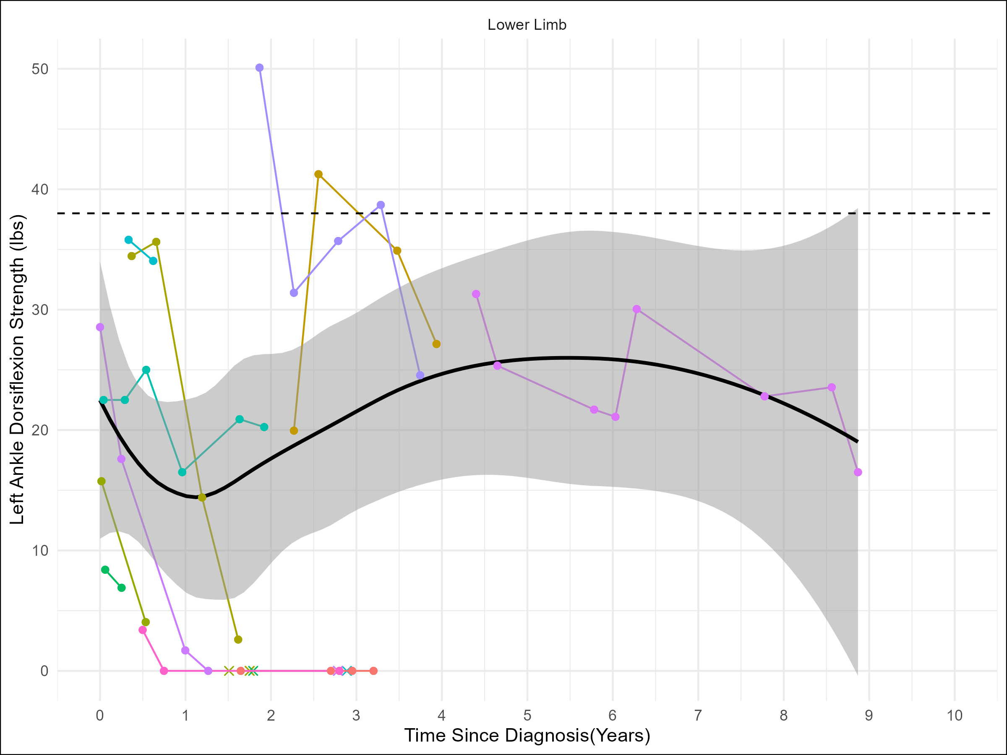
Figure 6: Left ankle flexion with bulbar (A; n = 18), upper limb (B; n = 12), and lower limb (C; n = 11) onset over time since diagnosis in months. Each colored line represents a different patient. A smoothed average line and shaded 95% confidence interval are applied to graphs where n > 10. A normative dashed black is displayed at 38 lbs. An ‘x’ indicates a patient death.

Slide 7
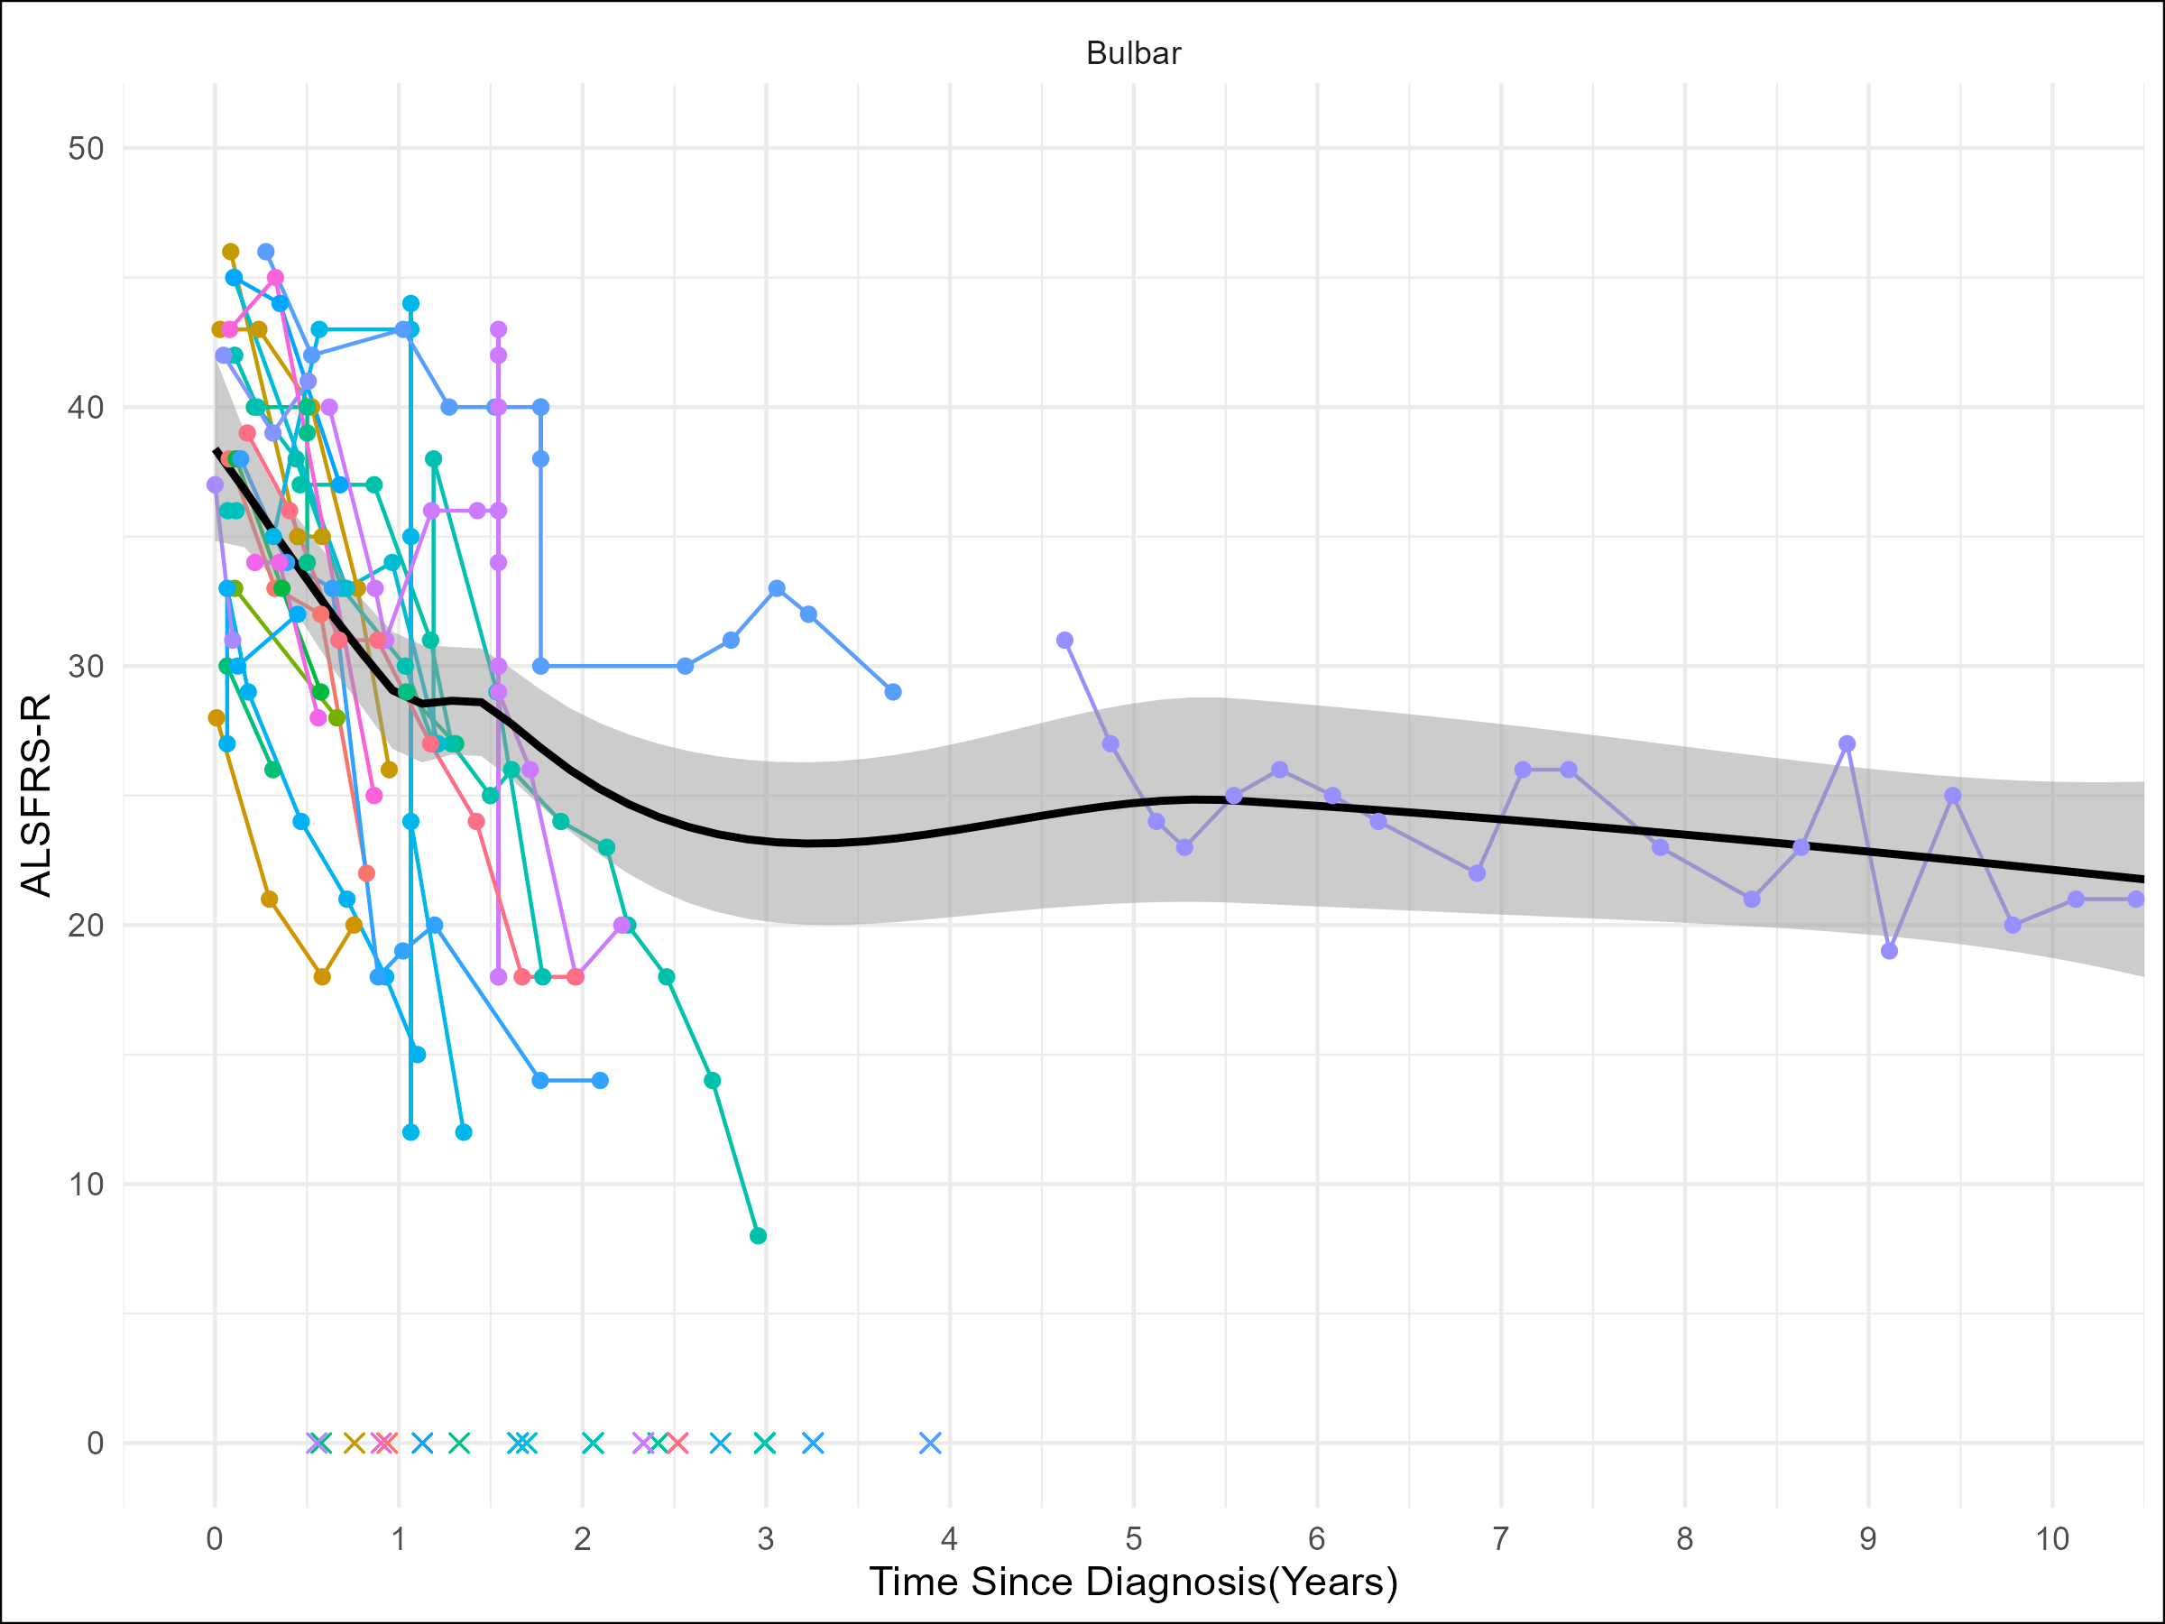
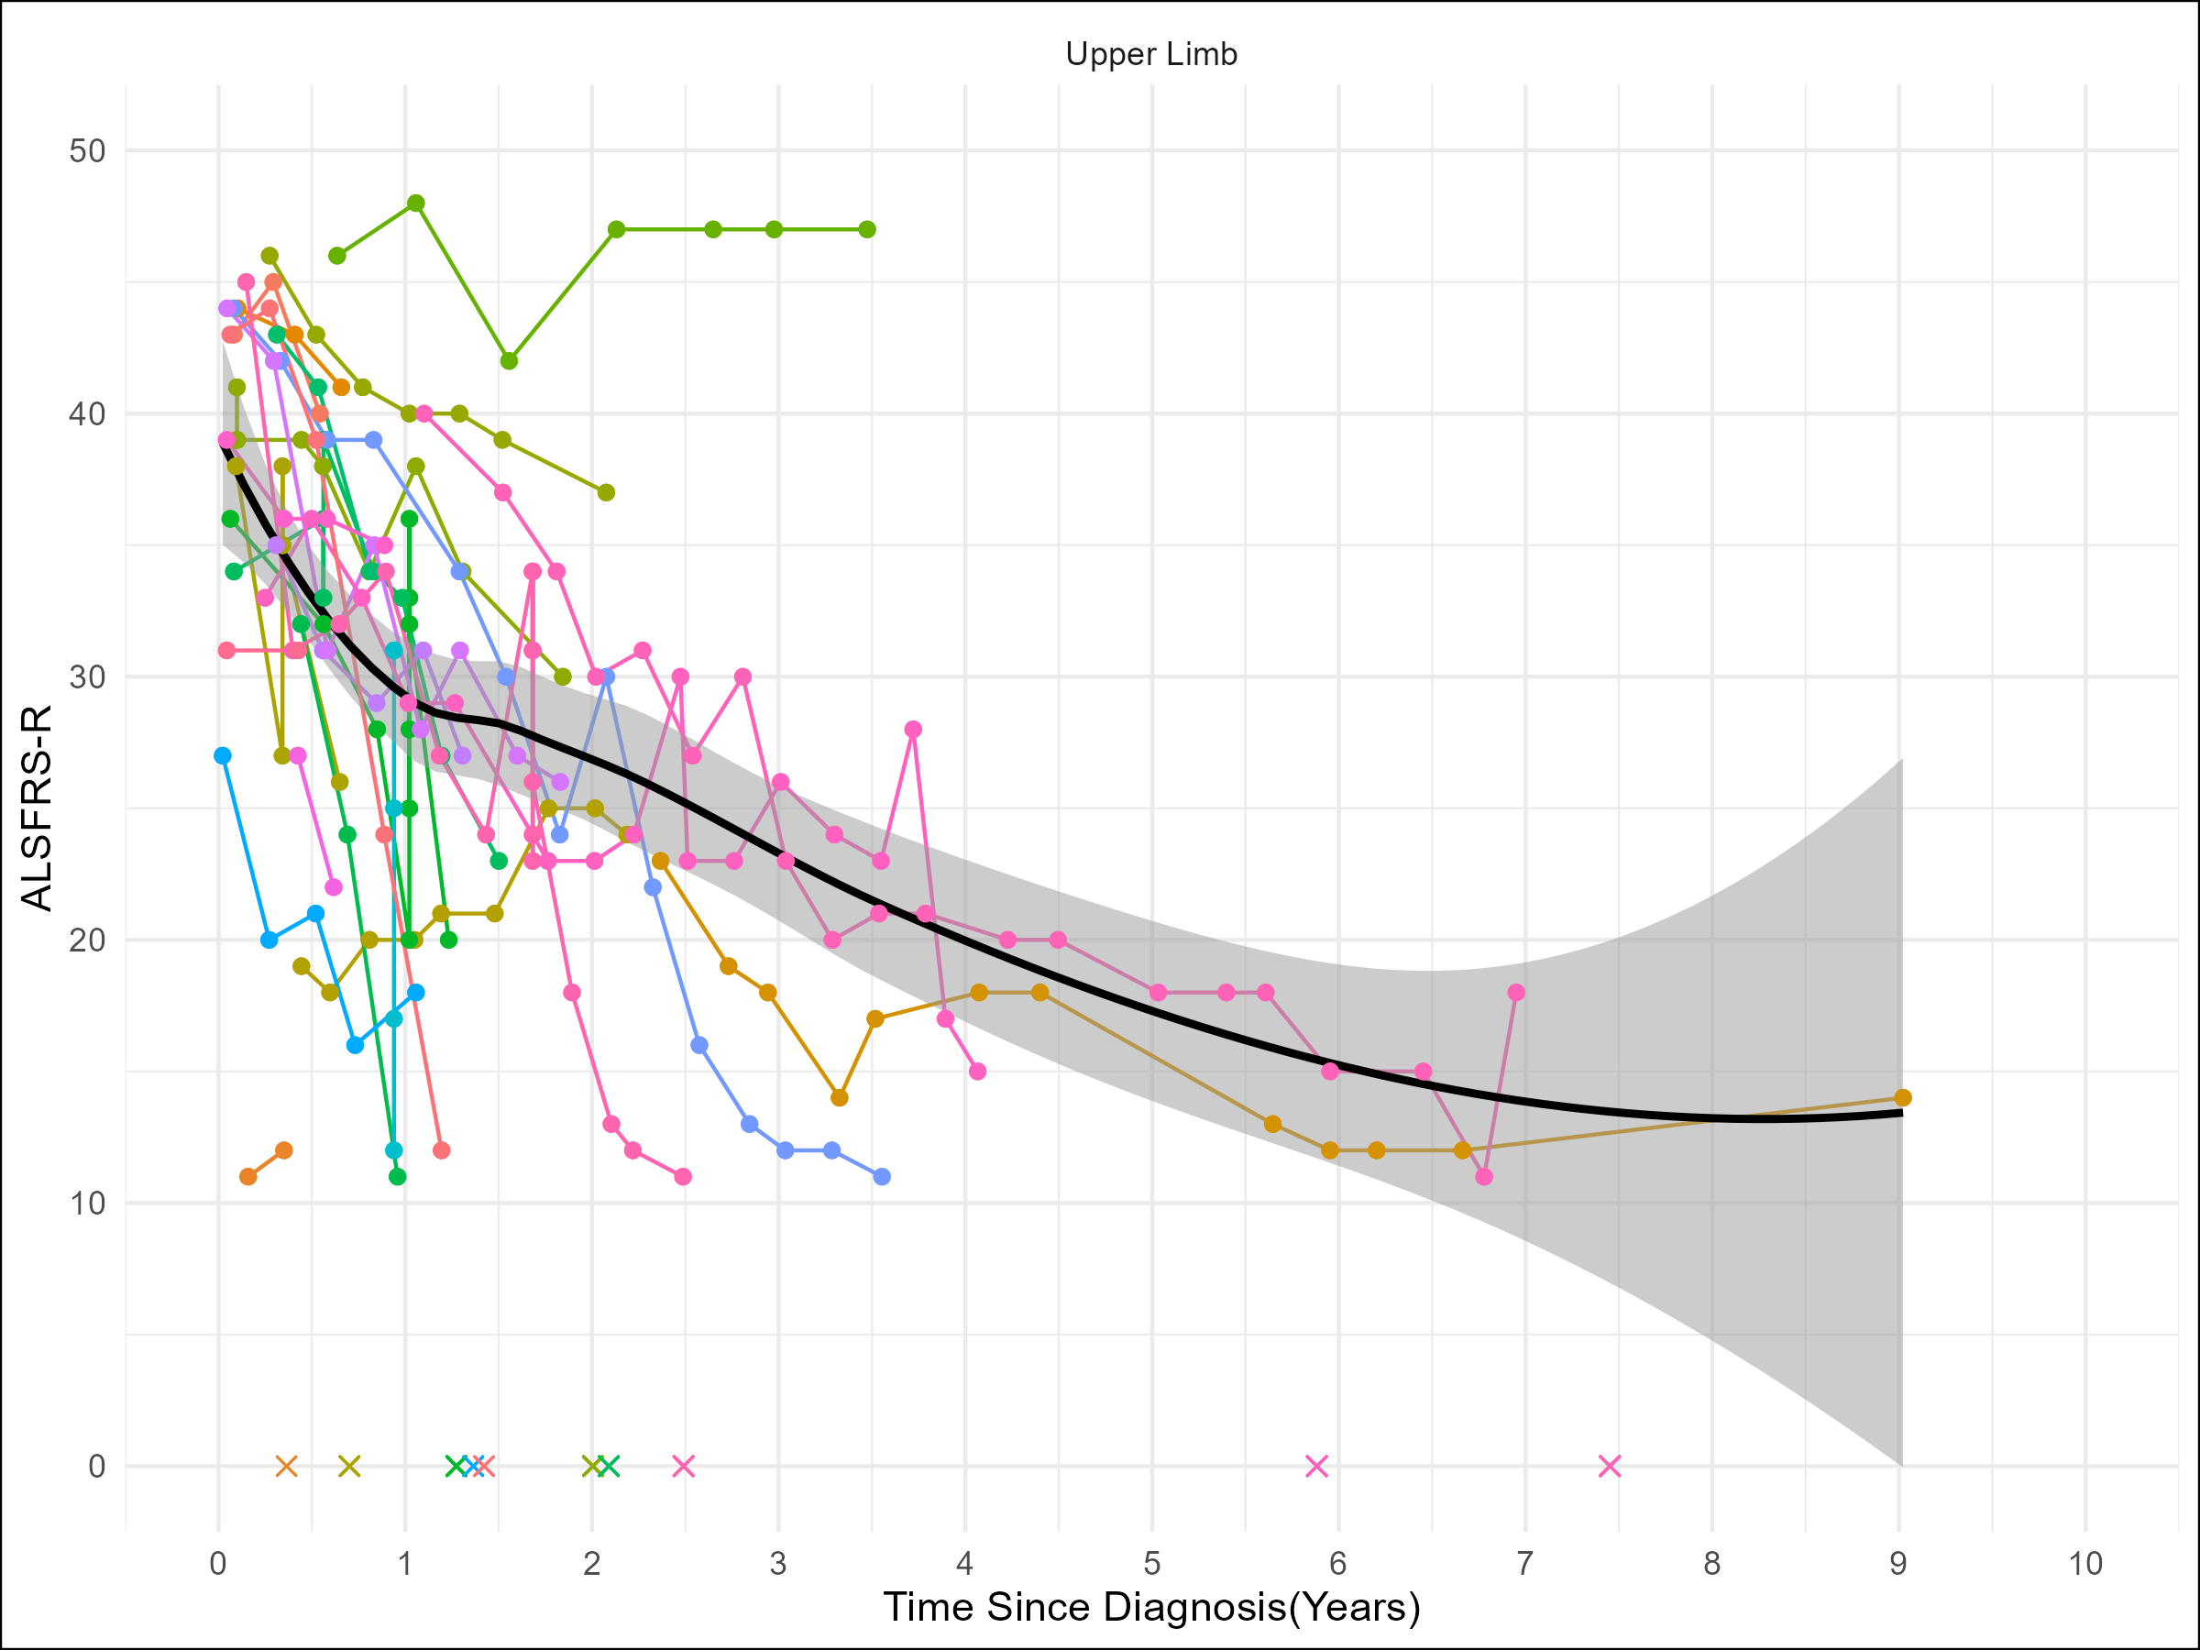
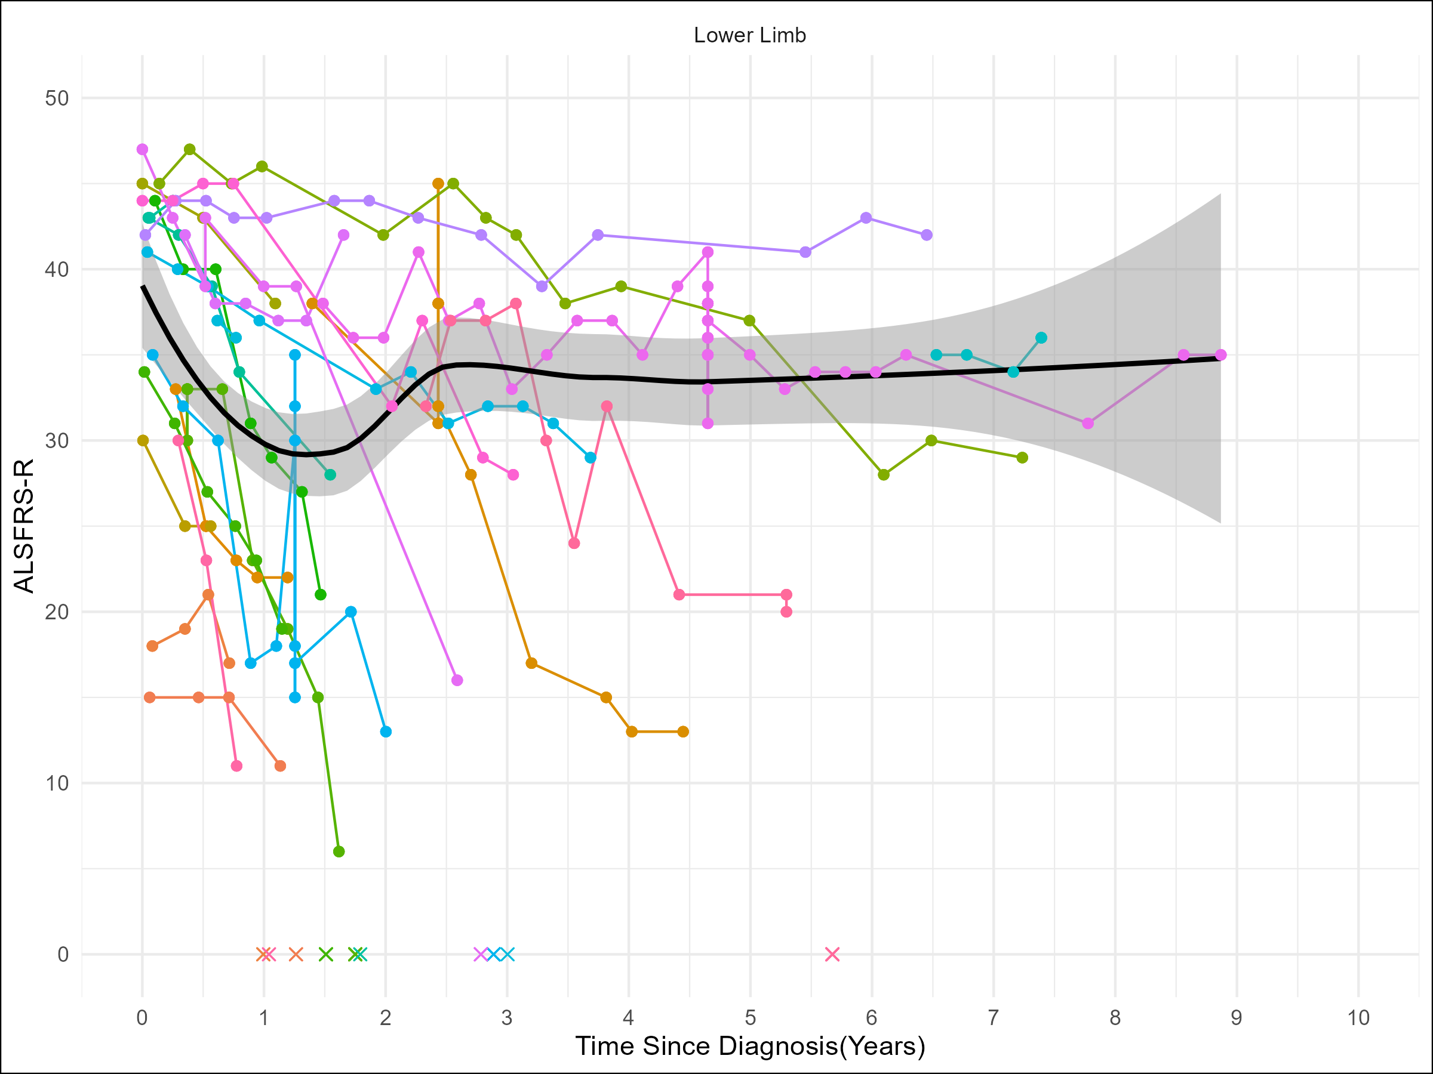
Figure 7: ALS FRSR survey data with bulbar (A; n = 23), upper limb (B; n = 25), and lower limb (C; n = 26) onset over time since diagnosis in months. Each colored line represents a different patient. A smoothed average line and shaded 95% confidence interval are applied to graphs where n > 10. An ‘x’ indicates a patient death.

Slide 8
